Slide 1
Basics of E-R Model
7

Slide 2
Today’s Agenda
Entity
Attribute
Relationship

Slide 3
Entity-Relationship (E-R)model
The E-R data model is based on the perception of a real world that consists of basic objects, called entities and of relationship among these objects.
The E-R model is a high level conceptual data model developed by Chen in 1976 to facilitate database design. A conceptual data model is a set of concepts that describe the structure of a database and the associated retrieval and updation on the database.
The basic concept of the E-R model is based on entity type, relationship type and attribute.

Slide 4
Components of E-R model
Entities
Attributes
Relationship

Slide 5
Entities
A real-world thing either living or non-living that is easily recognizable and nonrecognizable. It is anything in the enterprise that is to be represented in our database. It may be a physical thing or simply a fact about the enterprise or an event that happens in the real world.
An entity can be place, person, object, event or a concept, which stores data in the database. The characteristics of entities are must have an attribute, and a unique key. Every entity is made up of some 'attributes' which represent that entity.
Examples of entities:
Person: Employee, Student, Patient
Place: Store, Building
Object: Machine, product, and Car
Event: Sale, Registration, Renewal
Concept: Account, Course

Slide 6
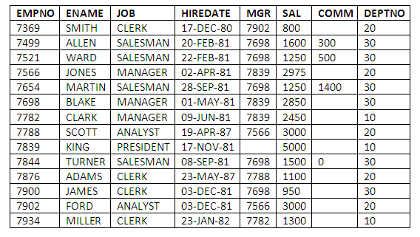
Example

Slide 7

Notation used in ER model Diagram
Entities are represented by rectangle either with round or square corners. For example if customer is an entity then it is represented as follows:

Slide 8
Continue
An entity is further classified into two types, i.e. tangible entity and intangible entity:
A tangible entity is one which physically exists in real-world. Such as a person, student, bank locker, etc. are examples of tangible entities, we can touch them as they physically exist.
An intangible entity is one which exists logically in real-world such as bank account, reservation, email account etc. Like a tangible entity, we can easily identify the intangible entity such as a bank account has an account no. using which we can easily identify that bank account, but we cannot touch it, as it doesn’t exist physically in the real world.

Slide 9
Attributes
Attributes describe the characteristics or properties of an entity in a database table. An entity in a database table is defined with the ‘fixed’ set of attributes. For example, if we have to define a student entity then we can define it with the set of attributes like roll number, name, course. The attribute values, of each student entity, will define its characteristics in the table.
In a relational database, we store data in the form of tables. The column header of the table represents the attributes. A table must not have duplicate attributes. Each attribute in a table has a certain domain which allows it to accept a certain ‘set of values’ only. In an entity, each attribute is allowed to have only one value which could be a number, text, date, time etc.

Slide 10
Attributes
Attributes describe the characteristics or properties of an entity in a database table. An entity in a database table is defined with the ‘fixed’ set of attributes. For example, if we have to define a student entity then we can define it with the set of attributes like roll number, name, course. The attribute values, of each student entity, will define its characteristics in the table.
In a relational database, we store data in the form of tables. The column header of the table represents the attributes. A table must not have duplicate attributes. Each attribute in a table has a certain domain which allows it to accept a certain ‘set of values’ only. In an entity, each attribute is allowed to have only one value which could be a number, text, date, time etc.

Slide 11
Key Differences Between Entity and Attribute
The basic difference between entity and attribute is that an entity is a distinguishable real-world object that exists, whereas attribute describes the elementary features of an entity.
In the relational database model entities are termed as record and attributes are termed as fields.
In the relational database model, we store data in the tables. So, the rows of table denote the entities and the column header of the table denotes attributes of an entities in a table.
An entity can either be a tangible entity or an intangible entity. On the other hand, the refinement of attributes includes the domain of attribute and key attributes.
The entities sharing the same elementary properties (attributes) are grouped in one entity set. The set of attributes that can distinguish an entity in a table is grouped to form a key.
The entire information of a single student in a student table represents an entity. The name, roll no, course parameters that form the complete information of a student are attributes of the student entity.

Slide 12
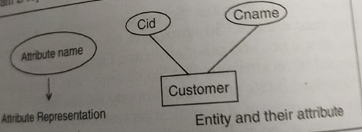
Attribute representation

Slide 13
Entity set
Entity Set
An entity set is a set of entities of the same type that share the same properties or attributes. The set of all person who are customers at a given bank can be defined as the entity set customer. Similarly the entity set loan might represent the set of all loans given by a particular bank.

Slide 14


